Slide 1


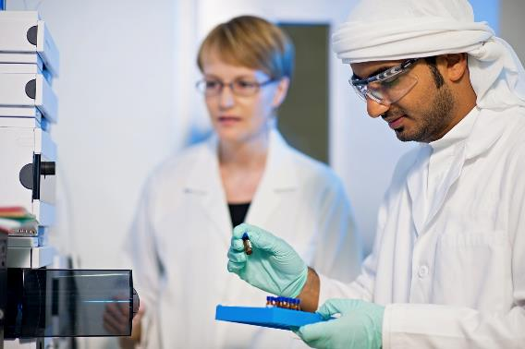
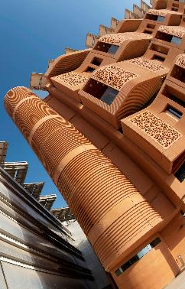
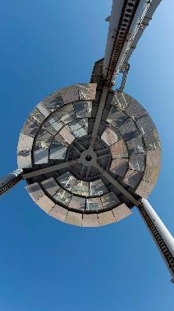
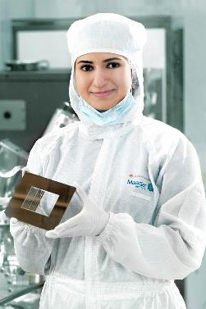
Research Computing requirements
Survey results

Slide 2
Overall Response to survey
We received a total of 68 responses to the survey
27 responses from the Sas Al Nakhl Campus.
13 responses from Masdar City Campus.
28 responses from Main Campus.
51 were faculty members
The remaining 17 were a mixture of postdocs, graduate students, and a research engineers.
Of the 68 respondents 43 had researchers, postdoc or grad students reporting to them. 25 had no direct reports
Combined these respondents were responsible for:
36 researchers, 35 post docs and 35 graduate students.
This is a much smaller sample size than the last survey.

Slide 3
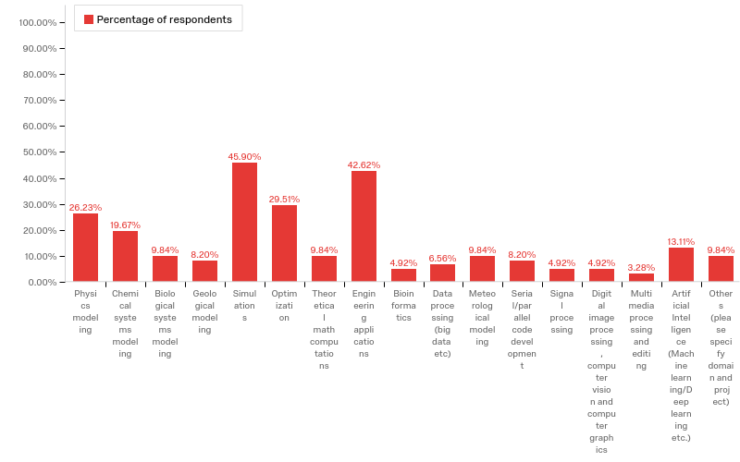
Q2.5 - Do you have any active projects in one of the following research areas?

Slide 4
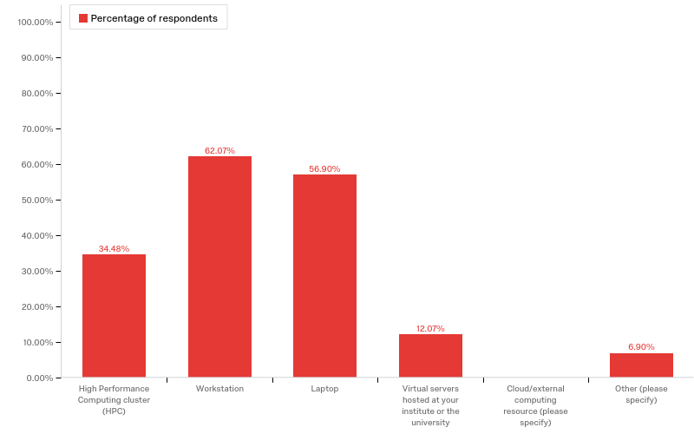
Q3.1 - Currently, how do you conduct research computing ? Select all that apply
Notes:
No research, none and desktop 4 years old

Slide 5
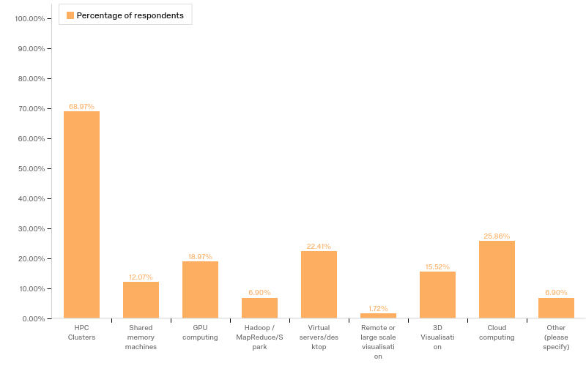
Q3.2 - What HPC / research computing technology do you want or hope to use over the next two years? Select all that apply

Slide 6
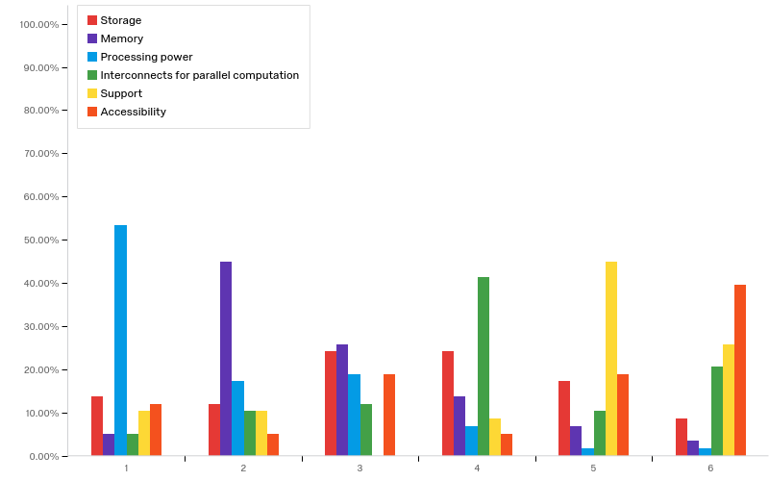
Q3.3 - Please rank the following in terms of importance , most important first.

Slide 7
Q3.4 - Overall, are the current research computing facilities adequate for your research? Are you able to address your research questions with current resources?
67% - “Yes, I am happy with current provision”
33% - “No, I am unable to carry out some research…”
Q3.5 - What are you is it that you are unable to do? E.g. study a larger system, more time steps, finer mesh etc..
The comments were overwhelmingly about studing larger systems, or using finer meshes. I.e. No comments about new technolgies or other change in direction.
A few comments on limitations due to software licnences.
There were a few comments about lack of knowledgable/adequate support both in terms of system adminsitration and HPC specific user support.

Slide 8
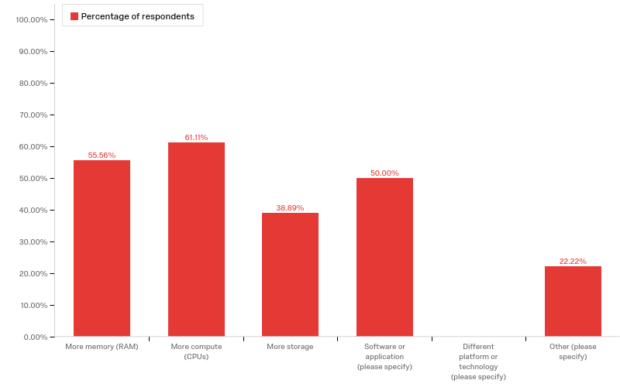
Q3.6 - What resource or tools do you need to remove these limitations?

Slide 9
Q3.6 - What resource or tools do you need to remove these limitations? Contd.
There is an emphasis on processing power and memory, with software applications being another important concern for the researchers.
Training of students was also mentioned

Slide 10
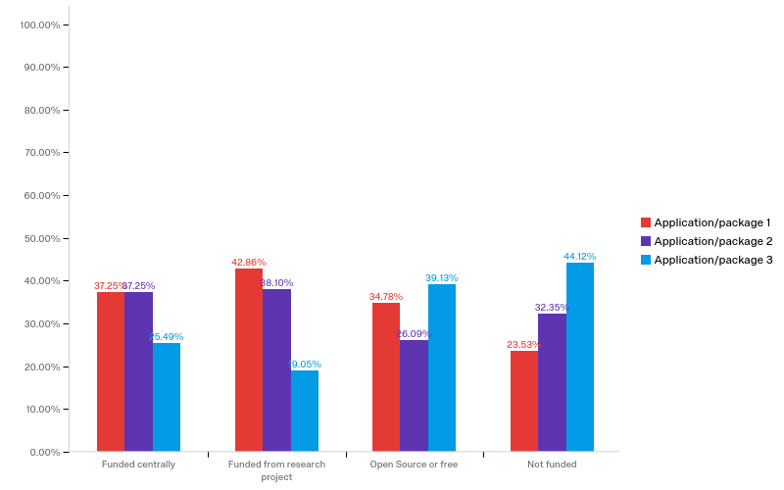
Q4.1 What are the top three essential software applications for your research ? Are they funded centrally or from research budget?

Slide 11
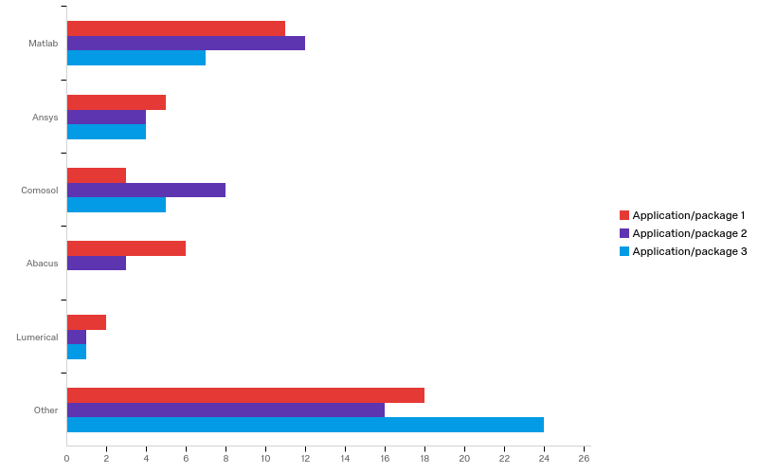
Q4.1 What are the top three essential software applications for your research ? Are they funded centrally or from research budget? Contd.

Slide 12
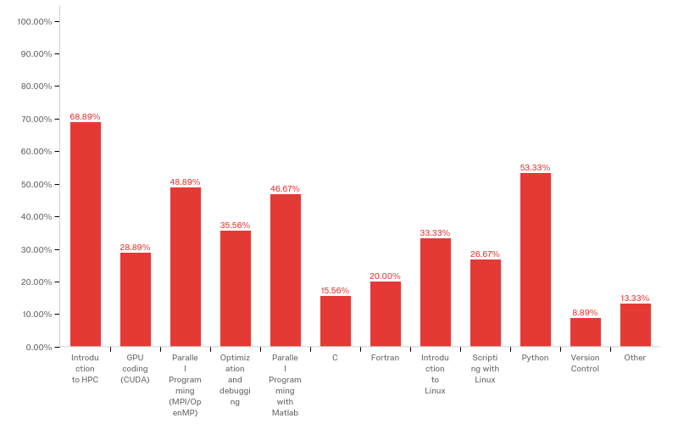
Q4.2 - What training courses would you find useful, pick all that apply

Slide 13
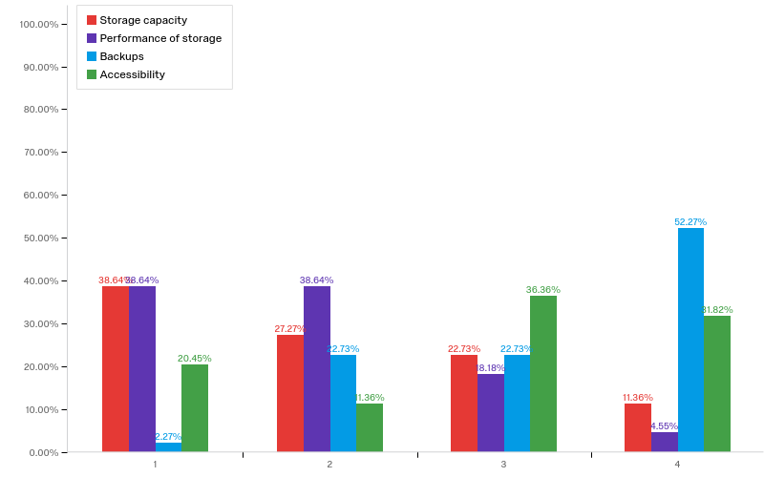
Q5.1 - Specifically for research data storage, please rank the following characteristics in order of importance, most important first

Slide 14
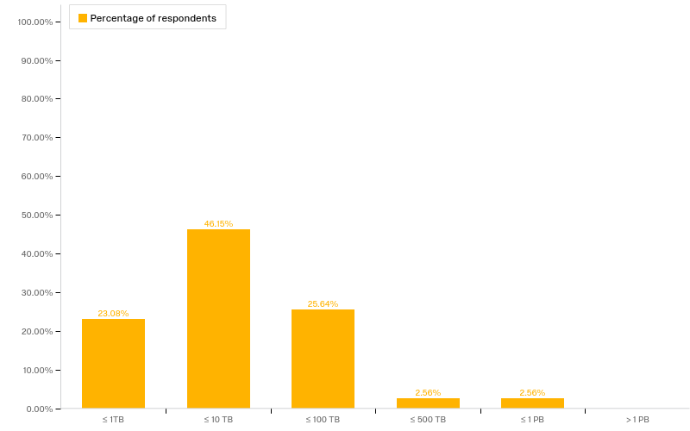
Q5.2 - How much storage do you need for your research data over the next two years?

Slide 15
Q5.2 - How much storage do you need for your research data over the next two years? Contd.
To put these numbers in context, currently research computing at Masdar have a total ~ 400Tb of storage, PI reported ~460Tb and 24Tb at Khalifa.
Q6.1 - How do you see your requirements changing over the next two years? For, instance do you anticipate a demand for new technologies? If so, what are they?
Generally, the comments were either stating that no change in technology or software is expected, or to ask for more compute power, support, and storage.

Slide 16
Q6.2 - Do you wish to add any other comments? e.g. specific application support or anything else we may have missed?
There was an emphasis on the need for support, both system administration and user support.
A few comments were around the desire to access HPC resources from all 3 institutions.
The number of software licenses was also mentioned.
One comment was requesting the KU webpages be updated!

Slide 17
Conclusion
The results do not show a significant change from the last survey.
The survey results strongly suggest that there is a large need for HPC resources
Some of this need is being met, but clearly more needs to be done
The emphasis is currently on more compute capacity, with storage being a secondary concern
The need for support, both system admin and user support, is another common theme
There is a need for basic HPC training as well as courses to enable researchers to better develop their own code, and make use of existing GPU resources

